Slide 1
Report of Activities in SIM and Working Group meeting
Raul Fernando Solis Betancur
Chair of the SIM Time and Frequency Working Group.

Slide 2
SIM WG meeting
Reports:
Chair activities.
SIM T&F Laboratories activities.
Working Group Organization:
Government (Chair and deputy Chair).
Term (2 year with one 2 year term or one term of 3 years).
Review for CMCs (inter regional and intra regional reviews).
Strategic plan for the next 3 years.
Things to see:
SIM Guidelines for time and frequency.
SIM Time & Frequency Working group forum.
SIM-BID projects.

Slide 3
SIM WG on TF in numbers
SIM has 20 NMI and 4 DI with time laboratories. But has 30 time laboratories if we include laboratories that no signed MRA and other organizations.
10 laboratories participating in key comparison CCTF-K001.UTC (8 NMI and 2 DI):
1 laboratory with TWGPPP, 5 with GPSPPP and 4 with GPS MC.
9 countries have CMC registered in the KCDB (7 NMI and 2 DI) with near of 86 entries.
4 NMI are directly involved in investigation of new standards and time transfer technologies (3 are from NORAMET).

Slide 4
SIM WG on TF in numbers
12 laboratories have Web clocks.
11 laboratories have Internet time through NTP servers.
6 laboratories with telephone time services.
5 laboratories with radio time code signal services.

Slide 5
MRA comparisons participation
Time Laboratory | UTC Acronym | Country | NMI / DI / Other | UTC | UTCr
NRC | NRC | Canada | NMI | Yes | Yes
NIST | NIST | United States | NMI | Yes | Yes
CENAM | CNM | Mexico | NMI | Yes | Yes
CENAMEP AIP | CNMP | Panama | NMI | Yes | Yes
INACAL | INCP | Peru | NMI | Yes | No
INMETRO | INXE | Brazil | NMI | Yes | Yes
ONRJ | ONRJ | Brazil | DI | Yes | Yes
INTI | INTI | Argentina | NMI | Yes | Yes
ICE | ICE | Costa Rica | DI | Yes | No
INM | INM | Colombia | NMI | Yes | No
*NMI in red. DI in blue.

Slide 6
SIM regional projects
SIM Time Network.
SIM Time Scale.
SIM NTP server comparison.
GPS receivers calibration campaign.
SIM Time and Frequency Working Group webpage.

Slide 7
SIM Time Network and Timescale
# | Country | Year of first participation | Time Standard
1 | United States | 2005 | Ensemble time scale
2 | Mexico | 2005 | Ensemble time scale
3 | Canada | 2005 | Ensemble time scale
4 | Panama | 2005 | Cesium
5 | Brazil | 2006 | Ensemble time scale
6 | Costa Rica | 2007 | Cesium
7 | Colombia | 2007 | Cesium
8 | Argentina | 2007 | Cesium
9 | Guatemala | 2007 | GPSDO
10 | Jamaica | 2007 | Cesium
11 | Uruguay | 2008 | Cesium
12 | Paraguay | 2008 | Rubidium
13 | Peru | 2009 | Cesium
14 | Trinidad & Tobago | 2009 | GPSDO
15 | Saint Lucia | 2010 | Rubidium
16 | Chile | 2010 | Rubidium
17 | Antigua and Barbuda | 2011 | Rubidium
18 | Ecuador | 2012 | GPSDO
19 | Bolivia | 2012 | Cesium
20 | St. Kitts & Nevis | 2014 | Rubidium
21 | Guyana | 2015 | Rubidium
22 | El Salvador | 2015 | Rubidium
23 | Dominican Republic | 2015 | Rubidium

Slide 8
SIM Time Network and Timescale
14 time laboratories (near of 61 % of SIM) obtain traceability through the SIM Time Network.
3 Countries (Peru, Costa Rica and Colombia) claimed CMC using bilateral comparisons with NMI with UTC(k) and CMCs in the network.
# | Laboratory | Country | Is MRA signatory?
1 | CENAME | Guatemala | No
2 | JBS | Jamaica | Yes
3 | UTE | Uruguay | Yes
4 | INTN | Paraguay | Yes
5 | TTBS | Trinidad & Tobago | Yes
6 | SLBS | Saint Lucia | Yes
7 | INN | Chile | Yes
8 | ABBS | Antigua and Barbuda | Yes
9 | CMEE | Ecuador | Yes
10 | IBMETRO | Bolivia | Yes
11 | SKBS | St. Kitts & Nevis | Yes
12 | GNBS | Guyana | Yes
13 | CIM | El Salvador | No
14 | INDOCAL | Dominican Republic | No

Slide 9
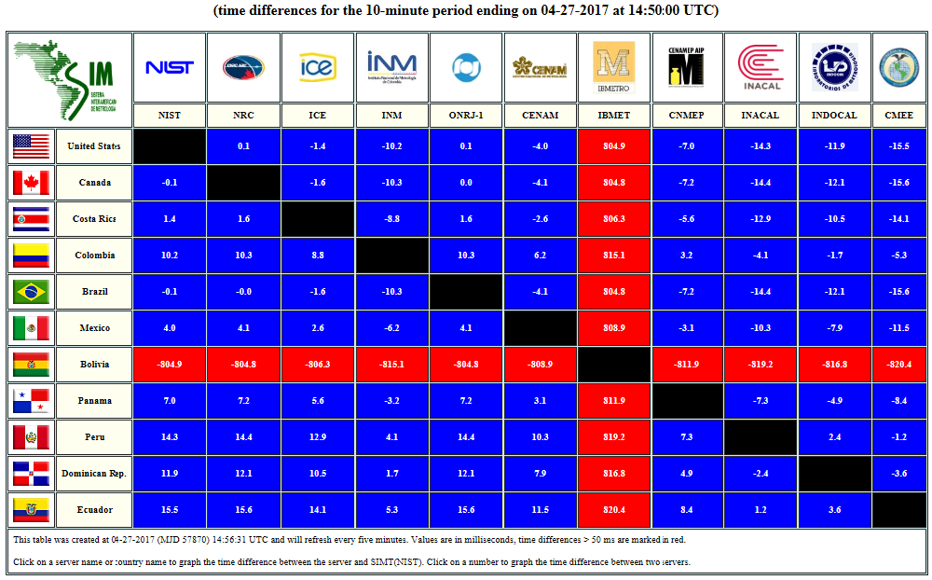
NTP servers comparison
SIM NTP Comparison: A comparison between NTP (Network Time Protocol) servers in SIM.

Slide 10
Receiver calibration campaign
First group (G1): USNO and NIST.
Second group (G2): is divided in two rounds:
Round 1: NRC, CENAM and CENAMEP.
Round 2: ONRJ, INMETRO and INTI.
In the second group, the round 1 is finished. We are expecting the starting of the round 2 calibration campaign.
This calibration campaign involved a lot of work by Dr. Stefania Römisch as responsible of this campaign.

Slide 11
Group webpage
NIST administrates and supports the Time and Frequency Working Group Web page (http://tf.nist.gov/sim).
Keeps information generated from the WG activities:
Publications & meetings.
Comparisons (Time Network, SIM time scale and NTP).
National Web clocks from SIM and
extra information about other NMI and organizations.
We think that being transparent and sharing the knowledge is the best way to advance.

Slide 12
Trainings in SIM
NIST invited metrologists from SIM to participate in their Time and Frequency Metrology Seminar in Boulder in 2016.
The Workshop on Time and Frequency of the T&F Working Group in Bogota in 2017.

Slide 13
Future
UTE (DI from Uruguay) show interest in become the DI in Time and Frequency and start to participating in UTC in the year 2018 (they come back to the SIMTN in September of 2017).
We estimate that between 2018 and 2019 SIM will have 11 time laboratories participating in UTC.
With the incoming emergent technologies, our WG will be one of the most strategic WG in SIM. We must keep working together for the benefit of our inhabitants.

Slide 14
SIM T&F Chair activities
With the help of the SIM T&F colleagues, SIM reviewed and approved CMCs from others RMO:
2016: 4 CMCs sheet from APMP, AFRIMETS and EURAMET.
2017: 1 CMC sheet from APMP.
In the CCTF-MRA (with Dr. Marina Gertsvolf and Dr. Mauricio Lopez), SIM review 4 CCTF-MRA document.
In the CCTF-MRA meeting in June of 2017, the Dr. Mauricio Lopez present the SIM activities in the period 2015-2017.

Slide 15
SIM T&F Chair activities
Training
In 2016, participation in the BIPM workshop “Leaders of Tomorrow”.
Quality Systems
Peer reviews in National Metrology Institutes in 2017.
SIM TC
Participation in the Technical Chair meetings in 2016 and 2017.

Slide 16
Thanks!

